Slide 1
Stanford CS231N Deep Learning for Computer Vision I 2025
Notes

Slide 2
Lecture 1
This lecture covers:
Computer vision overview
ImageNet - https://image-net.org/
Topics:
Deep learning basics
Perceiving and understanding the visual world
Generative and interactive visual intelligence
Human-centered applications and implications

Slide 3
Lecture 1
Image classification – a core task in computer vision
Linear classifier
Regularization & Optimization
Neural Networks
Perceiving and understanding the visual world
Tasks ----- Models
Tasks beyond image classification
Semantic segmentation (sky, grass, tree, cat…)
Object detection
Instance segmentation
Video classification
Multimodal video understanding
Visualization & understanding

Slide 4
Lecture 1
Models beyond multi-layer perception
Large scale distributed training
Data parallelism
Model parallelism
Synchronous vs. Asynchronous gradient update.
Self-supervised learning
Generative modeling
Image generation using diffusion models
Vision language models
3D vision – robotics

Slide 5
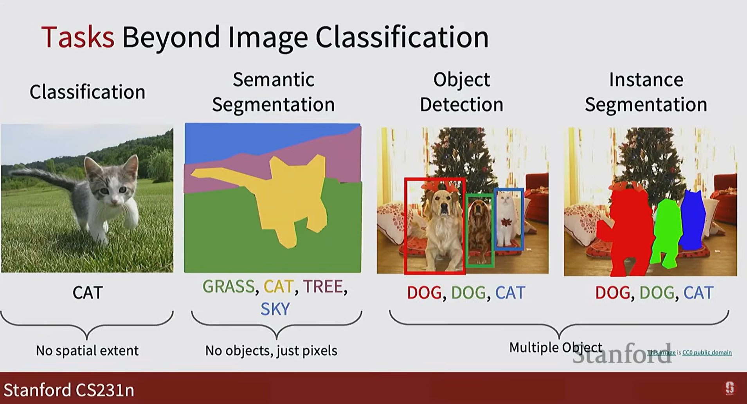
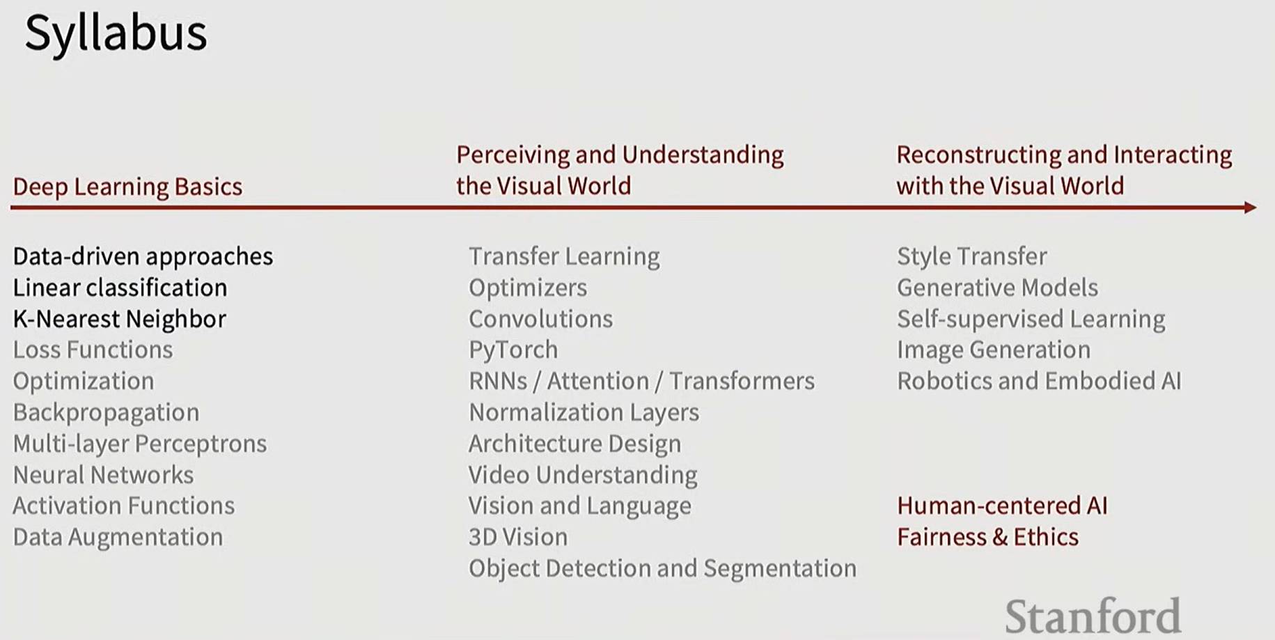

Slide 6
Lecture 2
Image Classification with Linear Classifiers
K-nearest neighbour and linear classifier
An Image is a tensor of intergers between [0, 255], 3 channel RGB
All changed if camera moved (view point changed)
Illumination changes
Background clutter
Zoom in & out (scale)
Occlusion (hide under a blanket, under coach cusion)
Deformation
Intraclass variation
Context

Slide 7
K- Nearest Neighbor

Slide 8
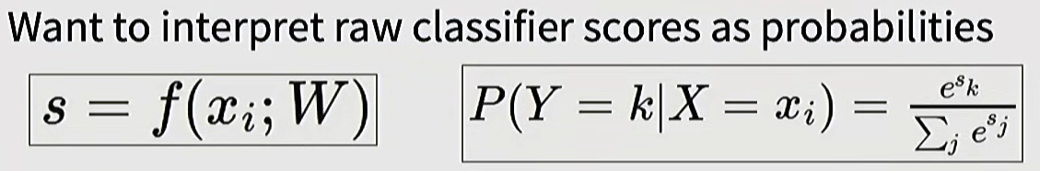
Linear Classifier
Parametric Approach
F(x, W) = W x + b
Softmax Classifier (Multinomial Logistic Regression)
Loss function

Slide 9
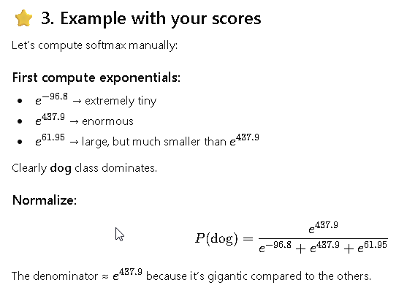
Softmax()
scores = [
-96.8, # cat score
437.9, # dog score
61.95 # ship score
]

Slide 10
Lecture 3
Regularization:
Data loss: Model predications should match training data
Regularization – prevent the model from doing too well on training data
Occam’s Razor: among multiple competing hypoetheses, the simplest is the best. William of Ockham 1285-1347
Lambda – regularization strength (hyperparameter)
L2 Regularization
L1 Regularization
Elastic net (L1+L2)

Slide 11
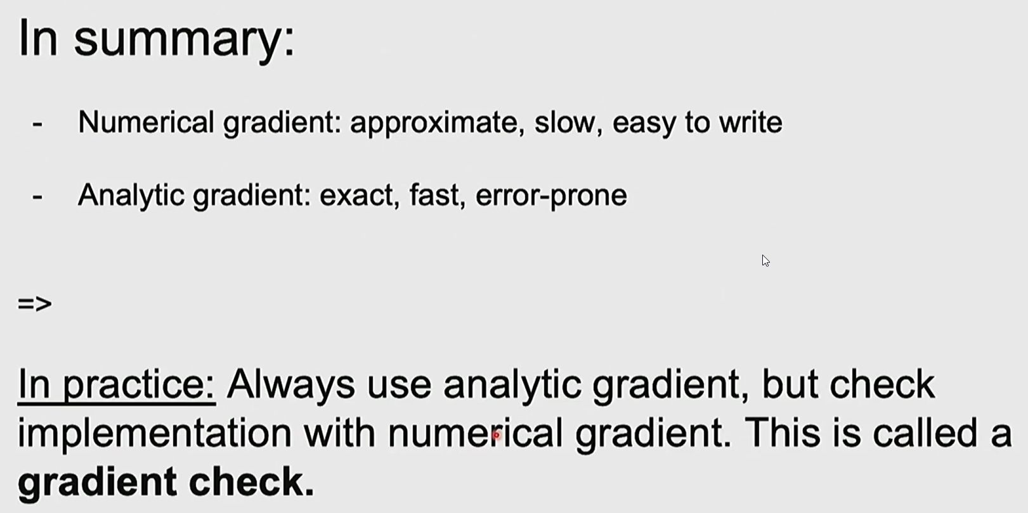
Regularization
Why regularize:
Express preferences over weights
Make the model simple so it works on test data
Improve optimization by adding curvature
Optimization

Slide 12
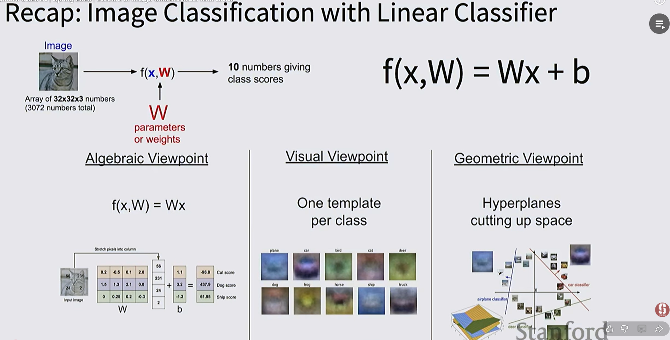

Slide 13
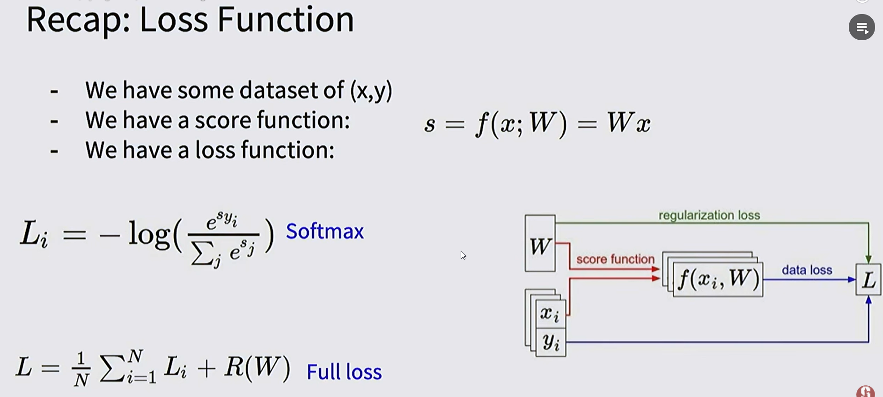

Slide 14
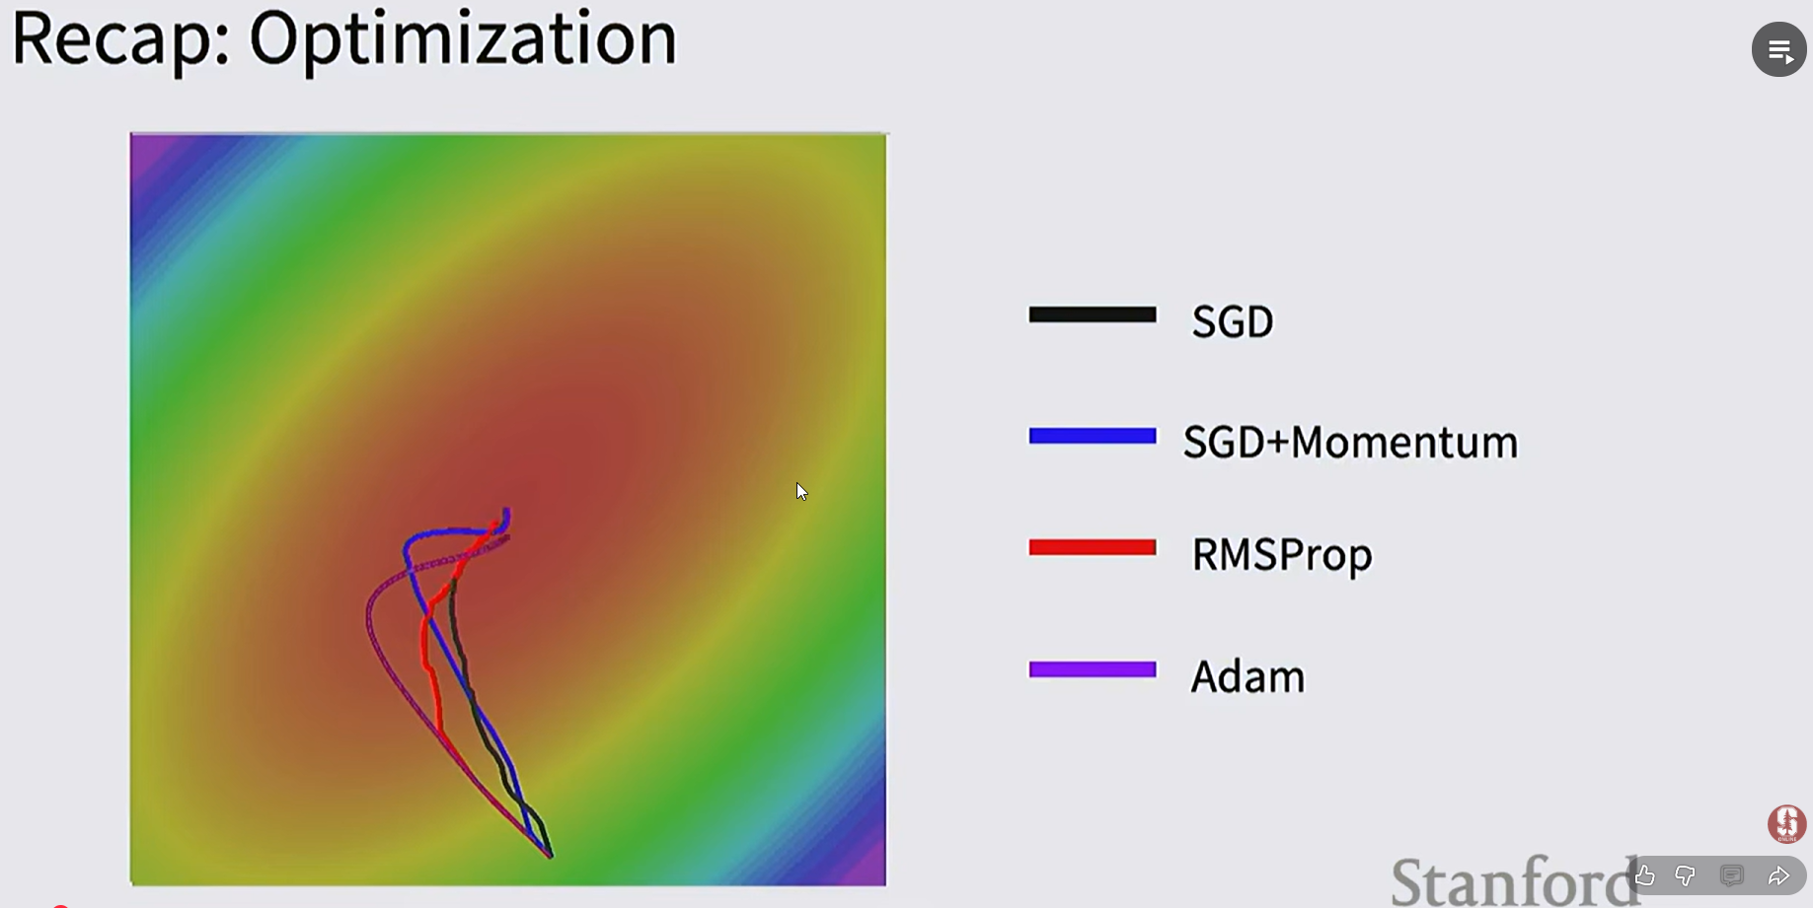

Slide 15
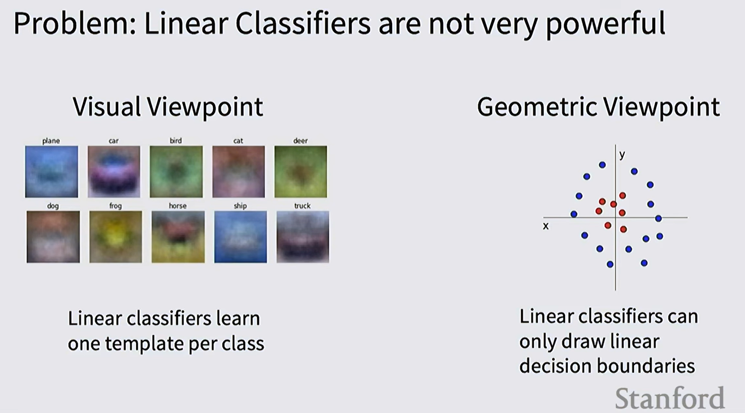

Slide 16
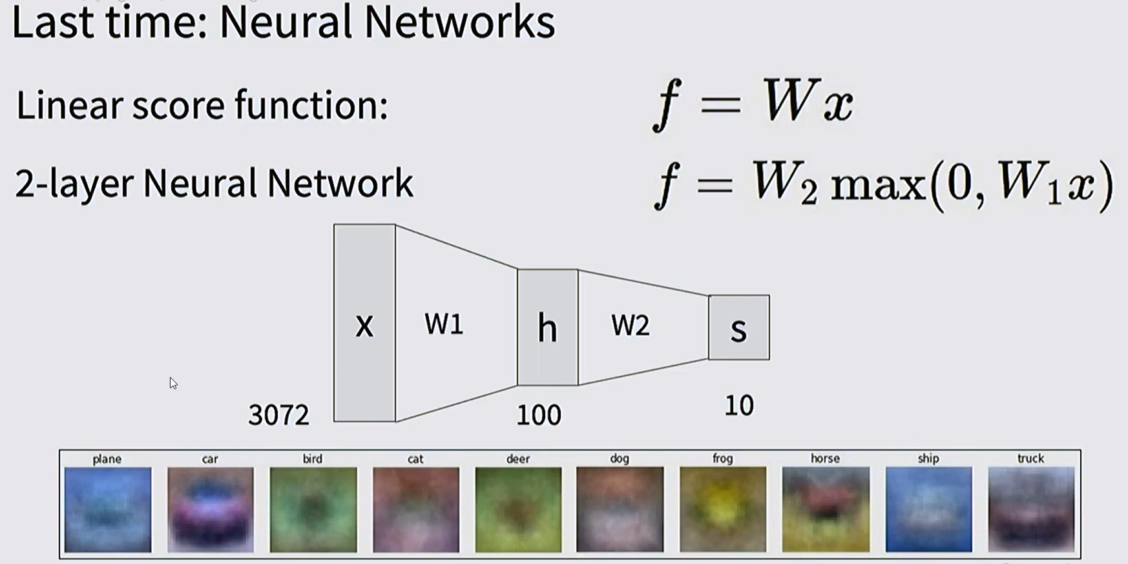

Slide 17
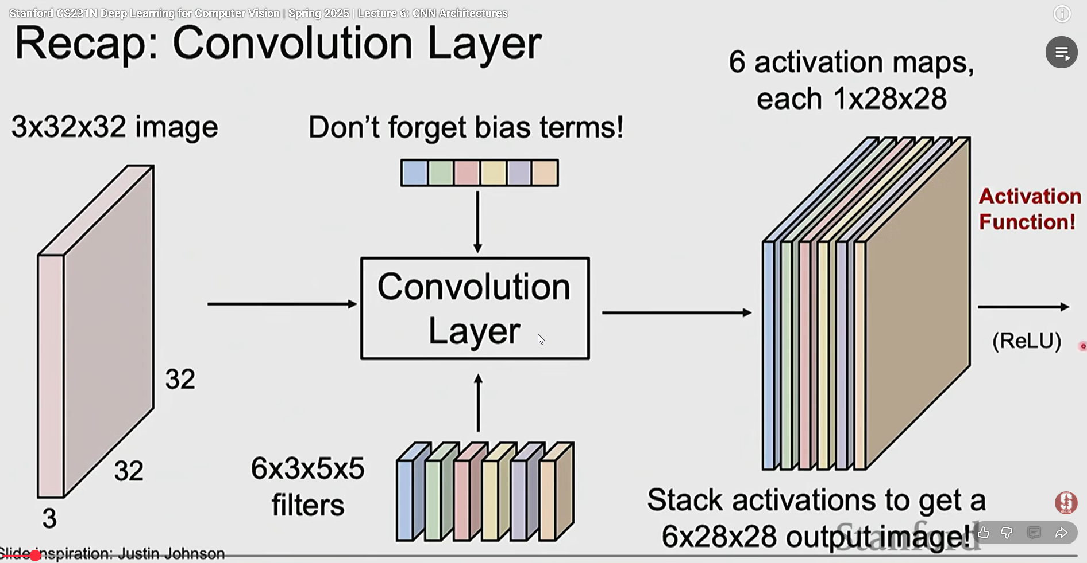
Convolutional NN

Slide 18
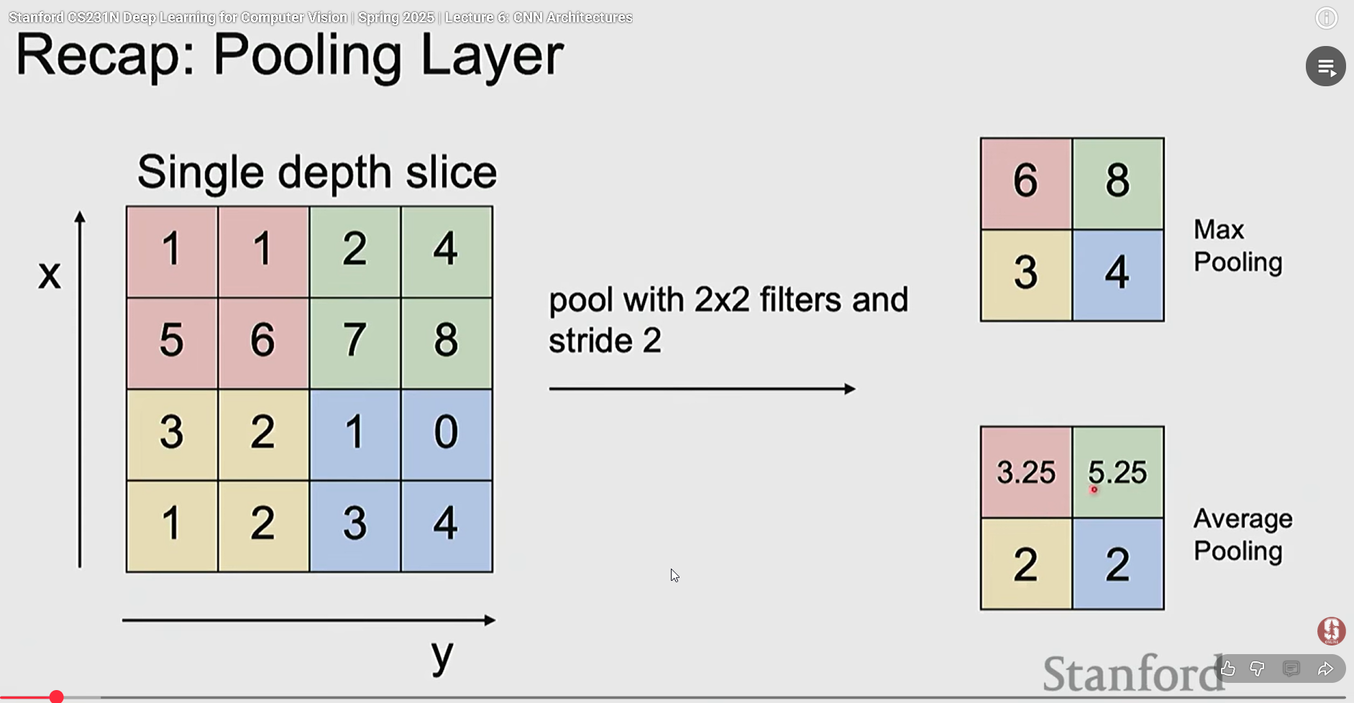

Slide 19
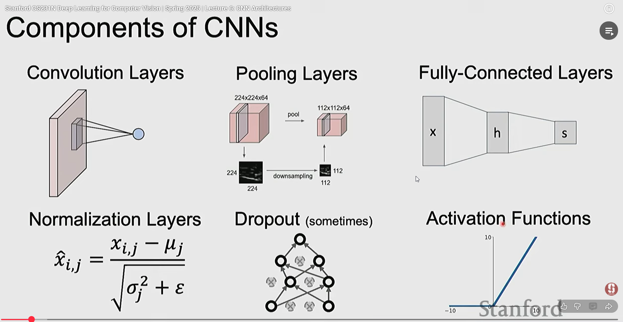
Layes in CNN

Slide 20
Recurrent Neural Network

Slide 21
